Slide 1
EXPENSE TRACKER BY USING PYTHON BASIC FUNCTIONALITIES
NAME : PRASANTH M
DATE OF SUBMISSION : 29/05/2024

Slide 2
1. AIM OF THE PROJECT
The primary objective of the project typically revolve around creating a code to help users manage their expenses efficiently.
The user might be a person or a small business firms.
Focuses on fundamental concepts like data input, manipulation, and basic user interface in python.

Slide 3
2. PROBLEM STATEMENT
The business problem addressed by an expense tracker Python project is the need for individuals or small businesses to effectively manage their finances.
This project aims to alleviate these issues by providing a user-friendly solution for recording and categorizing expenses
In a business context, this expense tracker can be particularly beneficial for small businesses or freelancers who need to monitor their expenses for tax purposes or client billing..

Slide 4
3. Project Description
The Expense Tracker Python project aims to provide individuals and small businesses with a user-friendly solution for managing their finances efficiently.
Scope Limitation:
This code will focus on basic expense tracking functionality and will not include advanced features such as budgeting or forecasting.
This code will allow one user at a time to tracking their expenses.
User will manually input their expenses data into the function.

Slide 5
Methodology :
The methodology used in the provided code follows object-oriented programming (OOP) principles and procedural programming paradigms.
Object-Oriented Programming (OOP)
Procedural Programming
User Interaction
Data Management

Slide 6
4. Functionality:
ExpenseTracker Class: It serves as a blueprint for creating expense tracker objects.
`add_expense` method
`view_expenses` method
`delete_expense` method
Main Function :
The `main` function serves as the entry point of the program.
The while loop is a control flow statement that repeatedly executes a block of code as long as a specified condition is true.

Slide 7
5. Input Versatility with Error Handling and Exception Handling
This Expense Tracker program showcases robust input handling mechanisms. It ensures user-friendly interactions by accepting one types of input and implementing error handling to prevent crashes.
1. Input Validation : When adding an expense, the program prompts users to input the category and amount. It employs error handling mechanisms to validate user input for the amount, ensuring it's a valid number. If an invalid input is detected, the program prompts the user to enter a valid number, preventing runtime errors.
2. Category Flexibility : The program converts the expense category input to uppercase, allowing users to input categories in any case format they prefer. This enhances user experience by providing flexibility in category naming.
3. Exception Handling : The program utilizes exception handling to gracefully manage unexpected errors. For instance, if a user tries to delete an expense category that doesn't exist, the program catches this exception and provides a user-friendly error message, preventing program termination due to unhandled exceptions.

Slide 8
6. Code Implementation
Input Handling : The program accepts user input for expense categories and amounts. It ensures flexibility by converting category inputs to uppercase, allowing users to input categories in any case format they prefer.
Expense Management : Users can add, view, and delete expenses by category. The program maintains a dictionary to store expenses, allowing efficient tracking.
Exception Handling : Exception handling is implemented to gracefully manage unexpected errors. For instance, when attempting to delete a nonexistent expense category, the program catches the exception and provides a user-friendly error message.

Slide 9
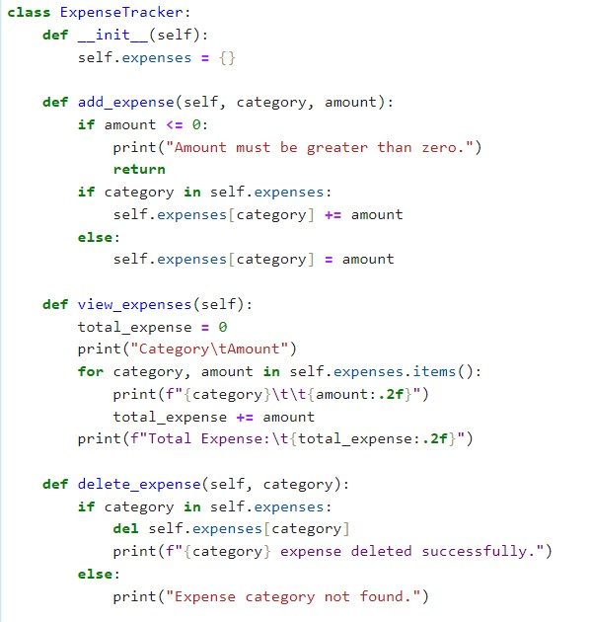
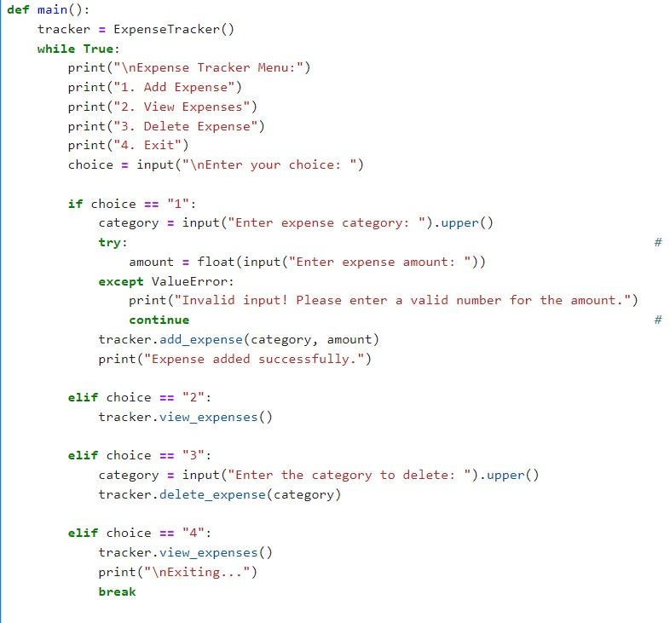

Slide 10
7.Results and Outcomes
1. Enhanced User Experience : The program's ability to handle various input formats and validate user inputs ensures smoother interactions.
2. Improved Financial Management : With the Expense Tracker, users can efficiently track their expenses by category.
3. Error Prevention : Robust error handling and exception management prevent crashes and ensure the program's stability. Users are guided through the input process, reducing the likelihood of input-related errors.
4.Time Savings : The program's efficiency in tracking and managing expenses saves users time and effort.
5.Reliability : The implementation's robustness instills confidence in users regarding the accuracy and reliability of expense tracking. Users can trust the program to accurately record and manage their expenses over time.

Slide 11
8. Conclusion
The Expense Tracker project presents a robust solution for managing personal finances, offering users a user-friendly interface with versatile input handling and error management capabilities
Future Developments : Potential future developments include adding features such as expense categorization, budget tracking, and data visualization for deeper financial analysis. Integration with cloud storage for data backup and synchronization could further enhance usability and accessibility.

Slide 12
THANK YOU.

